Slide 1
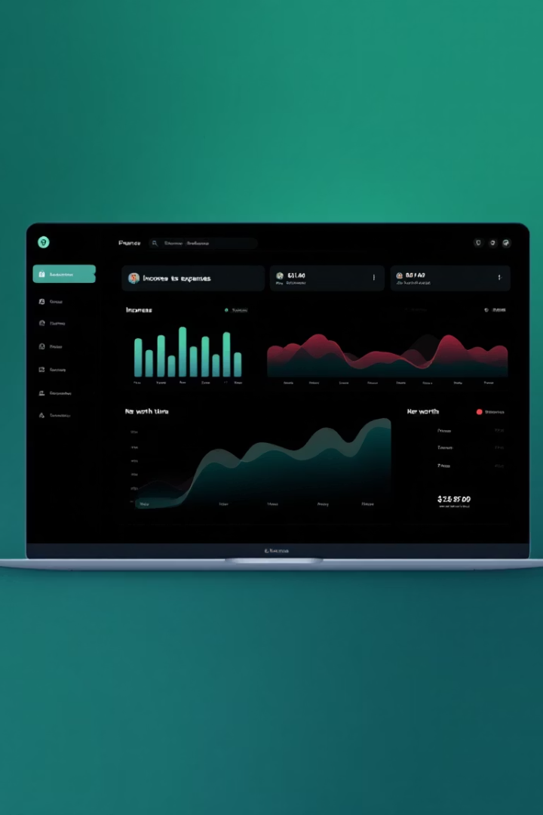

Welcome to Expense Tracker Pro
Your user-friendly solution for managing income, expenses, and budgets effortlessly.
by DUGGIRALA JNANA SATYA PRASAD
Veerla Venkata Sudheer

Slide 2
Simplify Your Finances
Quick Transaction Entry
Custom Categories
Budget Planning
Organize your spending.
Set and track budgets easily.
Log expenses in seconds.

Slide 3




Tools to Empower Your Finances
Spending Insights
Understand where your money goes.
Visual Charts
Track trends with ease.
Downloadable Reports
Share spending insights

Slide 4
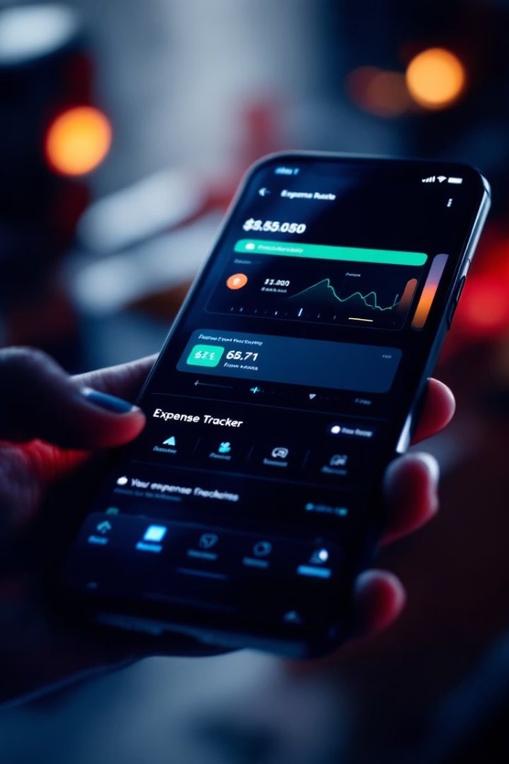
Beautifully Simple Design
Clean Interface
Mobile-Friendly
Easy to navigate.
Access anywhere.
Interactive Modals
Engaging experience.

Slide 5




Why You’ll Love It
Time-Saving
Free
Secure

Slide 6
Perfect for Everyone
Individuals
Freelancers
Families
Small Businesses
Personal finance simplified.
Track income and expenses.
Manage household budgets.
Keep finances in order.

Slide 7



Take Charge of Your Finances
1
Financial Freedom
2
Peace of Mind
3
Smart Spending

Slide 8
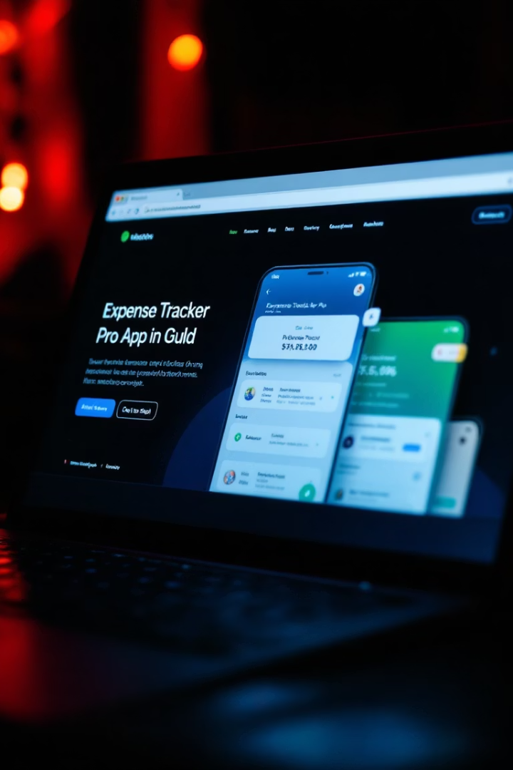
Try Expense Tracker Pro Today
Open index.html
in your browser to get started

